Slide 1
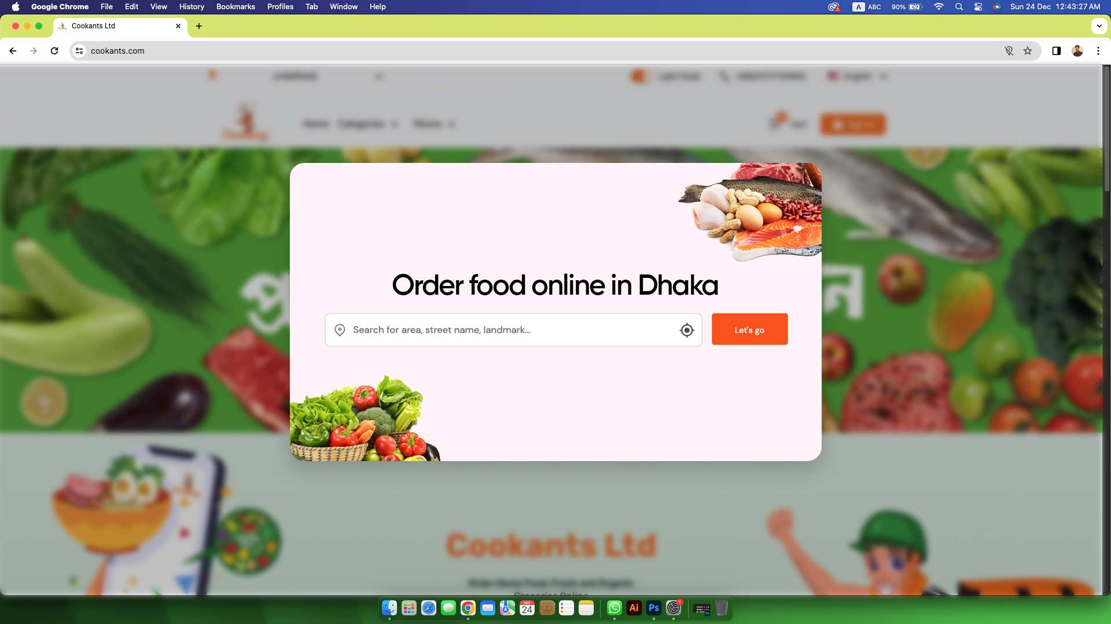
Location Page
When customer visit cookants.com, web from page visible on the screen, 1st page will be a popup Location conformation. When customer don’t input on the location but click lets go then system call default location Dhaka and show the products. When customer input location on the search option type letter then show Dhaka and Bangladesh based locations only. Show suggestion. Like type ‘d’ then suggestion show Dhanmondi, Dhamrai and others available location.

Slide 2
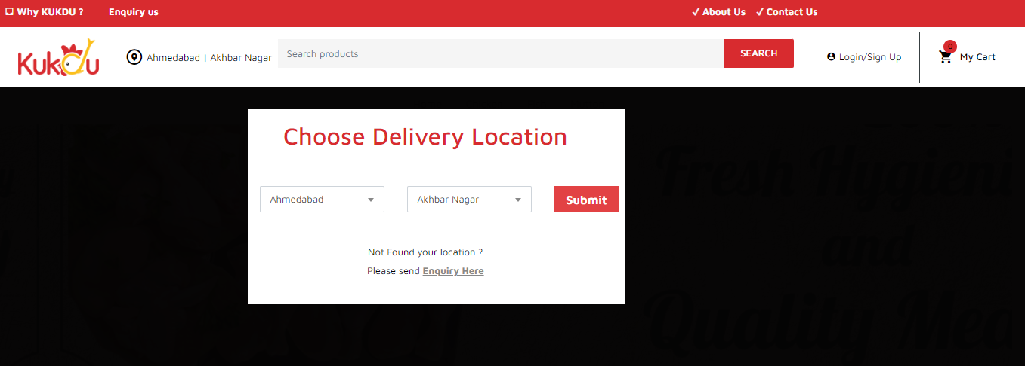
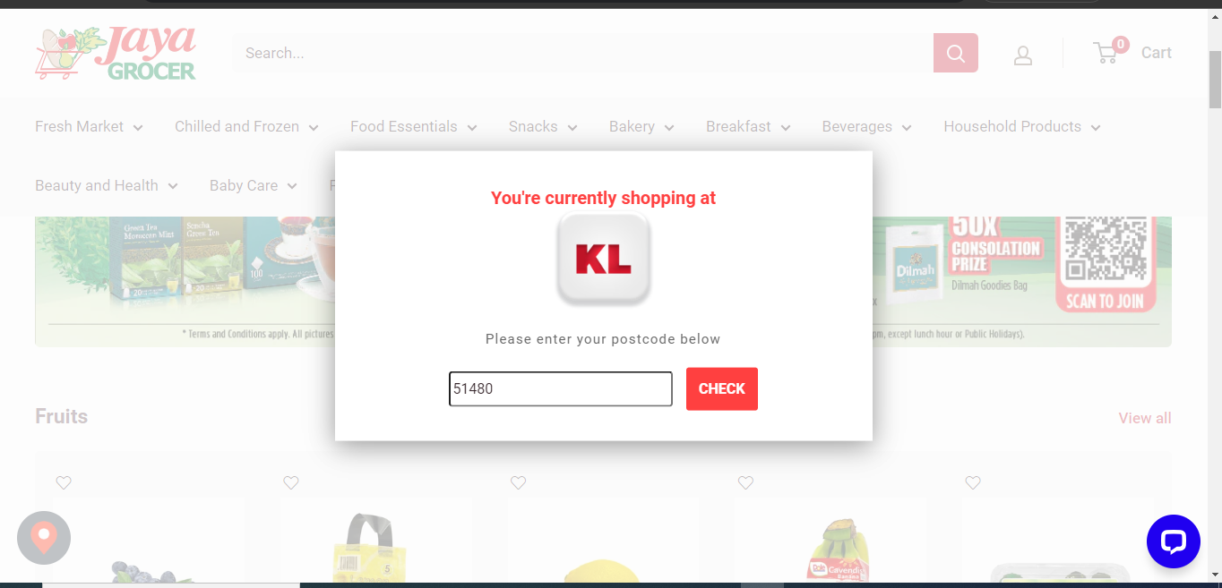
Before submit the location can’t visit this shop. I want like that.
Reference: https://klec.jayagrocer.com/

Slide 3
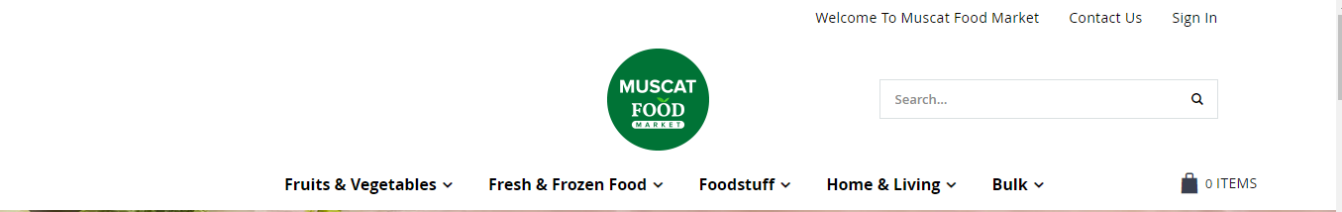

Header Tops: Will be dynamic
Header | Cookants Logo, Contact Us, Sign in, Location, language, Search, Shops, Wish List, Add To Cart

Slide 4
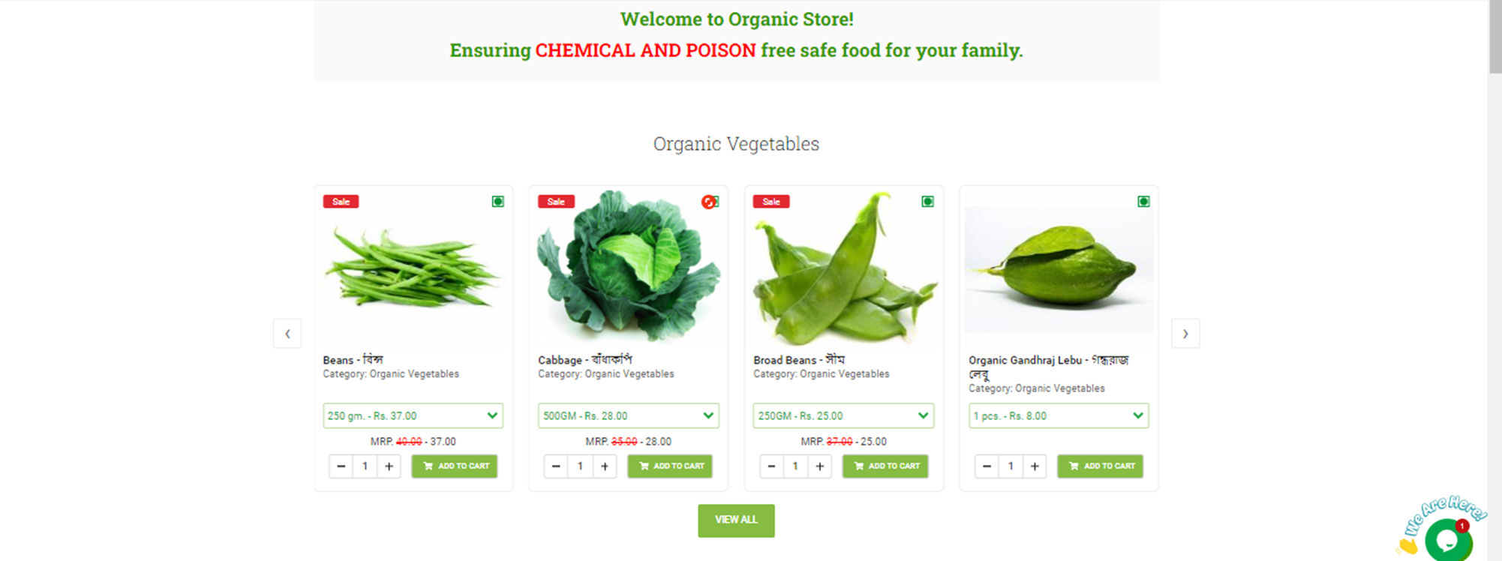
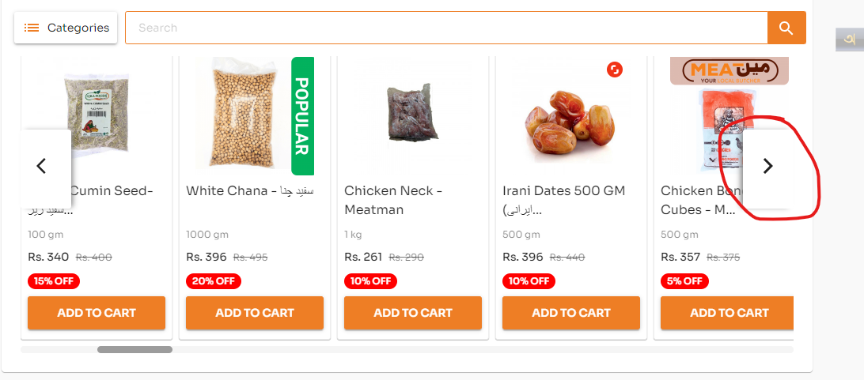
Slide 1: Popular Items. We want to show here all shops popular items/offer sales/Flash Sales/Hot Deals products. Its work as slider.
Need 1:3 (333:1000) size slider multiple banner on the upper of product categories, Stores, Slider also link with shop or products. Like the slider shop any meal 50Tk. Then when customer click on the slider customer move to offer meal page.

Slide 5
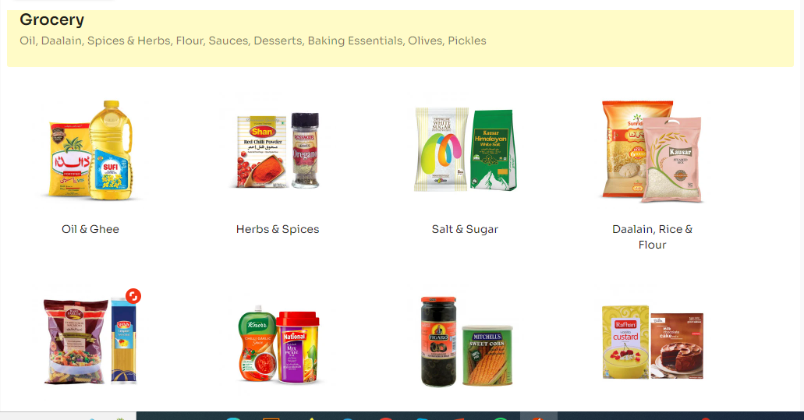
Shop like Grocery, Here we want Fresh Groceries. Show all products category: Fruits and Vegs, Meat, Fish etc. Reference: https://grocerapp.pk/ Fresh Groceries Firm fresh fruits and groceries here.

Slide 6
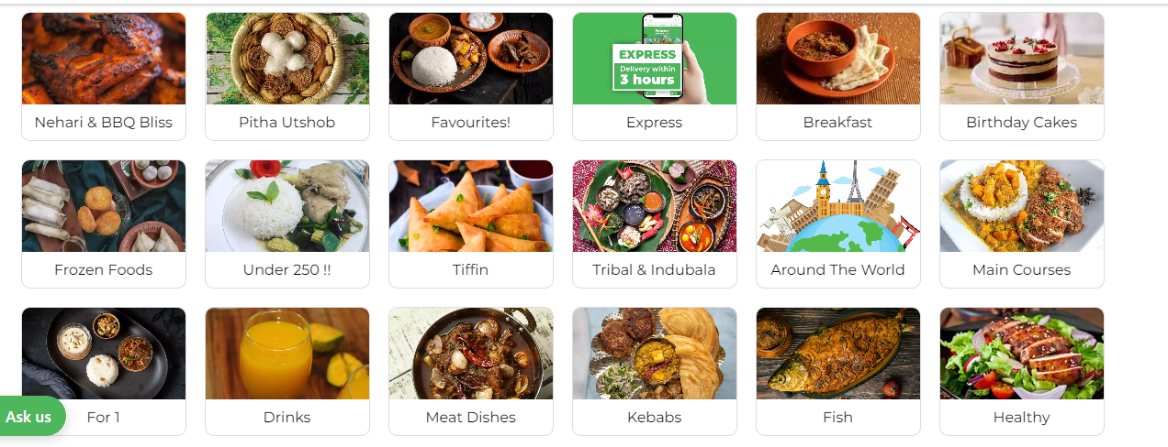
Shop name: Home food Taste, Hygiene And Nutrition Food Reloaded

Slide 7
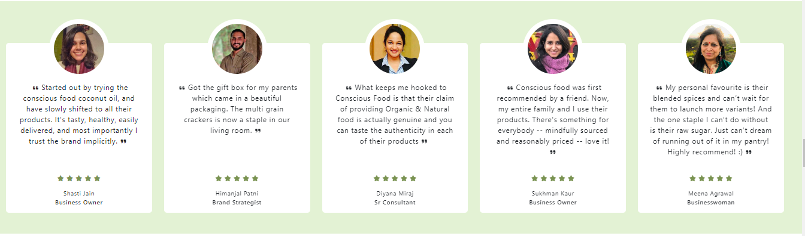
CUSTOMER SPEAK

Slide 8

Health E-book Blogs // Recipes//News//Photos //Videos

Slide 9
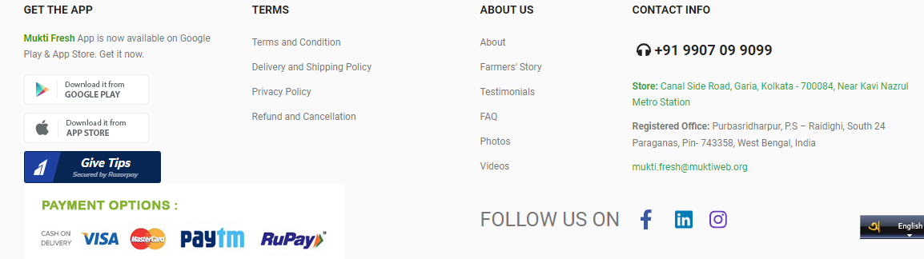
Footer:

Slide 10
Initially we don’t need all solution. For smooth operations we need to solve as much as possible.
Homepage SEO Audit Report
Initial need for product and category page
https://docs.google.com/spreadsheets/d/1pXycXnW1W5DDEj359CznmmEwOyHLr9G_/edit#gid=203231450
Location:
Show index name.
Create SEO friendly url
Confirm customer get smooth order journey from any page.
Product order time schedule.

Slide 11
Delivery charge:
Fresh Mart:
Home food
Delivery Charge variable for different shop, area, location and distance.
(X*km+Y(Fixed Value))*Z. When customer open the app inside Dhaka then delivery charge will be 60Tk or fixed: 30Tk and per km 3tk. From shop location.
When the order value will be Z then delivery charge will be free= like order value above 1500 then delivery charge will be free at 1st Dhaka city map. But out side Dhaka charge applicable.
Outside Dhaka: (X*km+Y)*Z=0+120=120Tk
(X*km+Y(Fixed Value))*Z. When customer open the app inside Dhaka then delivery charge will be 29Tk or fixed: 10Tk and per km 3tk. From shop location.
When the order value will be Z then delivery charge will be free= like order value above 500 then delivery charge will be free at 1st Dhaka city map. But out side Dhaka charge applicable.

